Slide 1
Networking with Kubernetes!

Slide 2
Part 1
Intro: K8S Networking

Slide 3
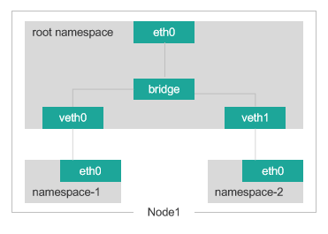
Namespace
Linux kernel has 6 types of namespaces: pid,net,mnt,uts,ipc,user
Network namespaces provide a brand-new network stack for all the processes within the namespace.
That includes network interfaces,routing tables and iptables rules

Slide 4

Live demo: Play with namespaces and cgroups.

Slide 5
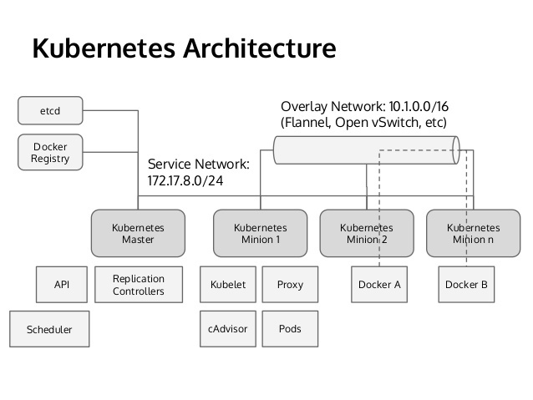

Slide 6
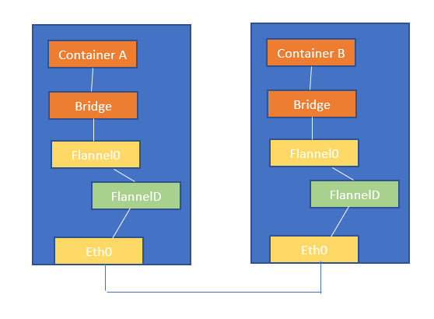
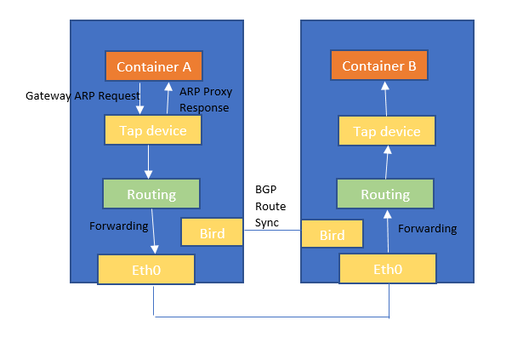
Flannel VS Calico
VS

Slide 7
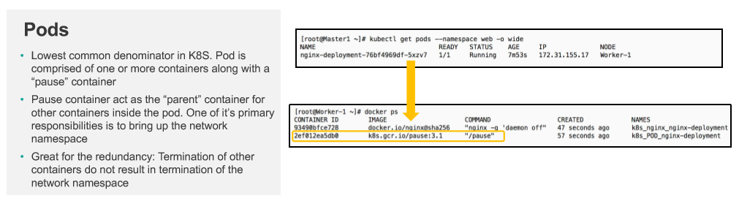
Pods

Slide 8
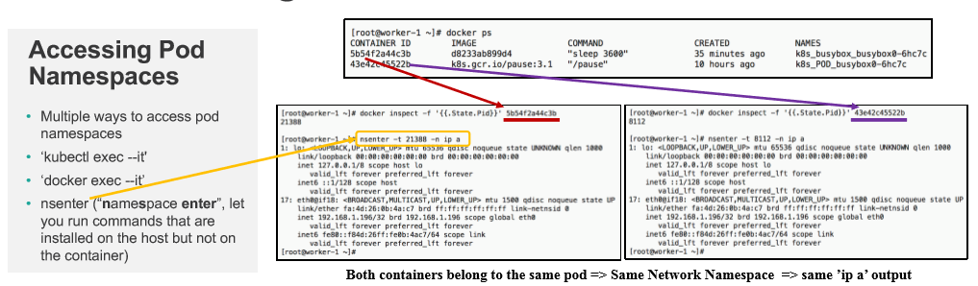
Accessing Pod Namespaces

Slide 9
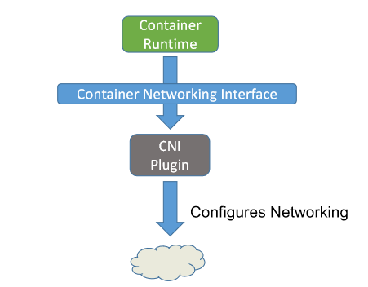
Container Networking Interface : CNI
Interface between container runtime and network implementation
Network plugin implements the CNI spec. It takes a container runtime and configure (attach/detach) it to the network
CNI plugin is an executable (in: /opt/cni/bin)
When invoked it reads in a JSON config & Environment Variables to get all the required parameters to configure the container with the network

Slide 10
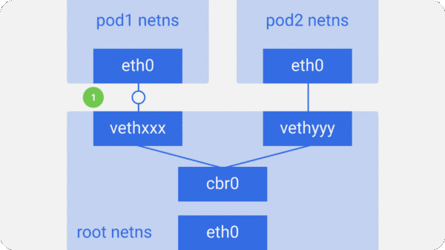
Intra-node communication

Slide 11
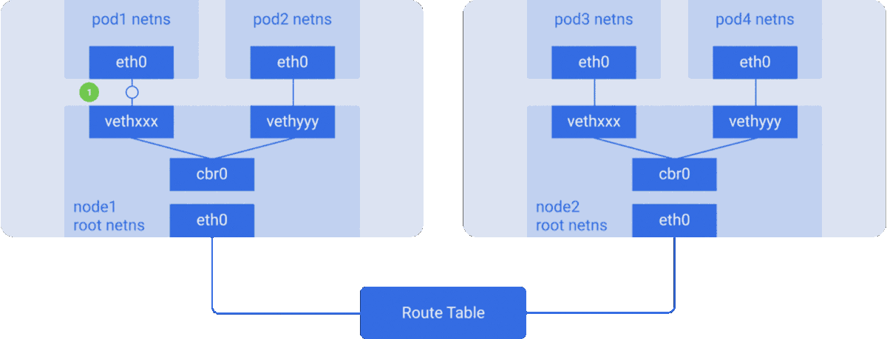
Inter-node communication

Slide 12
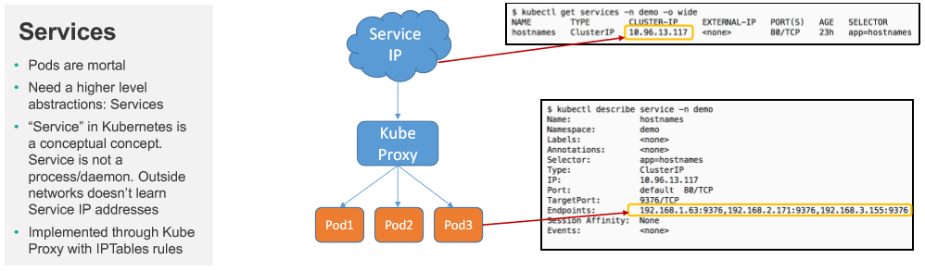
Back to the Basics

Slide 13

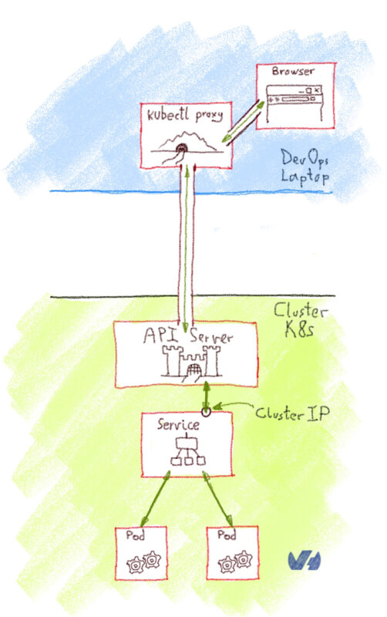
ClusterIP: Service is accessed via ‘ClusterIP’

Slide 14
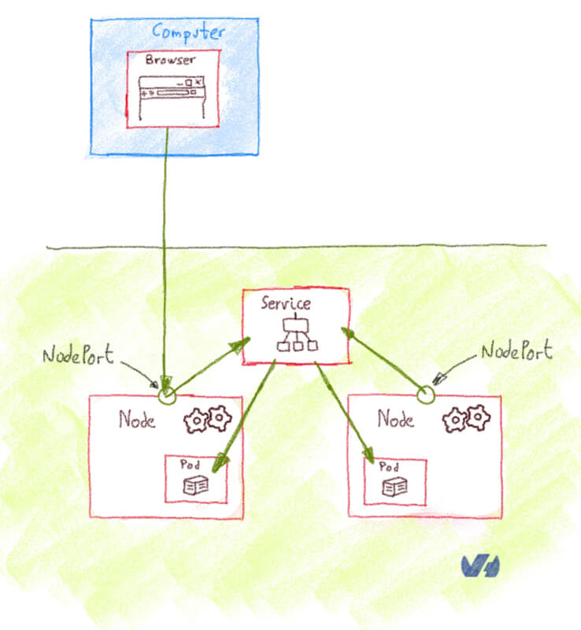
NodePort: Service is accessed via ‘NodeIP:port’

Slide 15
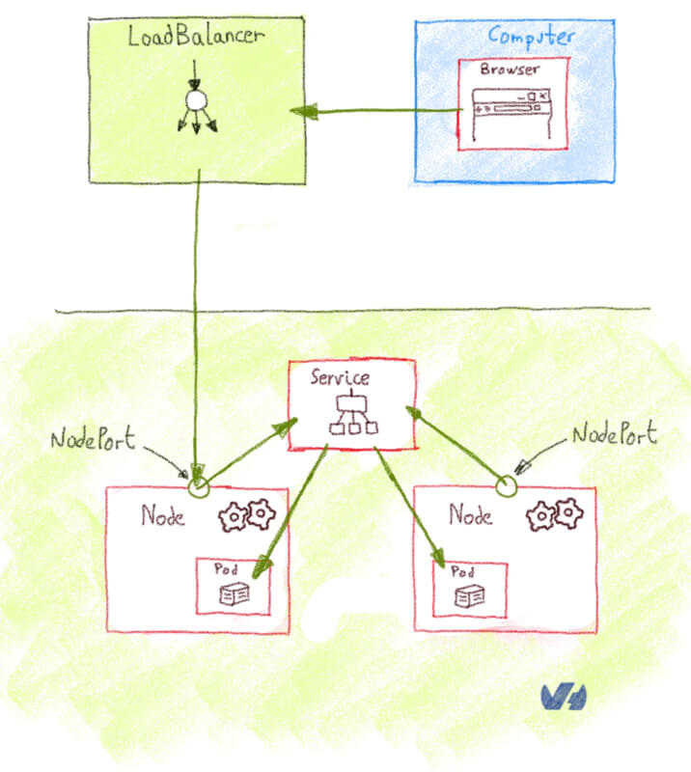
LoadBalancer: Service is accessed via Loadbalancer

Slide 16
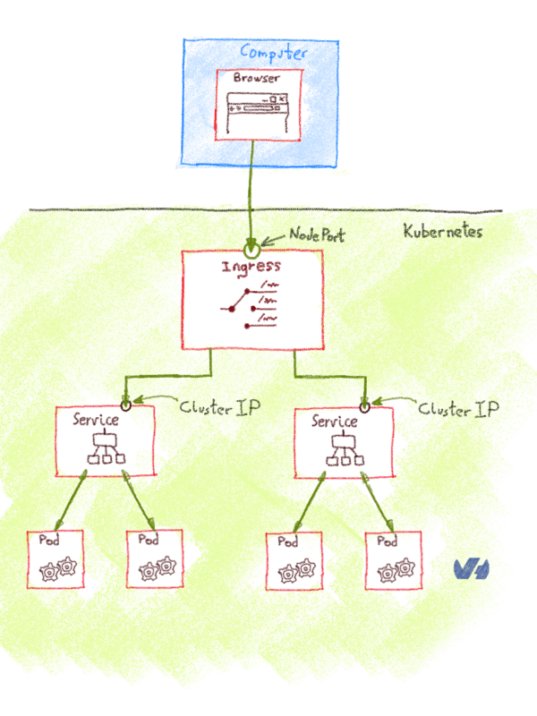
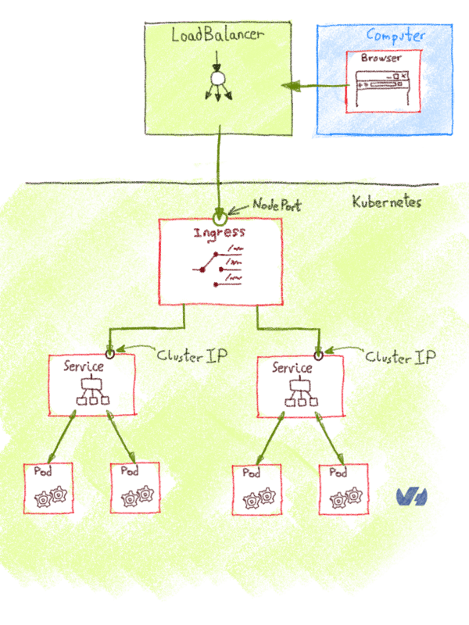
Ingress
Ingress is an API object that manages external access to the services in a cluster.
Ingress
Ingress behind Load Balancer

Slide 17
Part 2:
Setting up K8S The Hard Way
On top of Amazon Web Services (AWS)

Slide 18
1- Provisioning Compute Resources
https://github.com/TunisJAM/kubernetes-the-hard-way-aws/blob/master/docs/03-compute-resources.md
Networking:
VPC
Subnet
Internet Gateway
Route Tables
Security Groups (aka Firewall Rules)
Create a Network Load Balancer
Compute Instances:
Instance Image + SSH Key Pair
Kubernetes Controllers
Kubernetes Workers

Slide 19
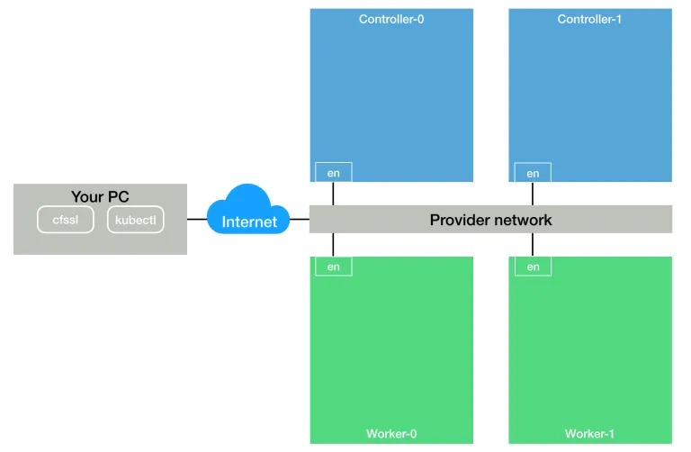
1- Provisioning Compute Resources
https://github.com/TunisJAM/kubernetes-the-hard-way-aws/blob/master/docs/03-compute-resources.md

Slide 20
2- Provisioning a CA and Generating TLS Certificates
https://github.com/TunisJAM/kubernetes-the-hard-way-aws/blob/master/docs/04-certificate-authority.md
Certificate Authority
Client and Server Certificates:
The Admin Client Certificate
The Kubelet Client Certificates
The Controller Manager Client Certificate
The Kube Proxy Client Certificate
The Scheduler Client Certificate
The Kubernetes API Server Certificate
The Service Account Key Pair
Distribute the Client and Server Certificates
Notes:
choco install kubernetes-cli
PS C:\Windows\system32>Invoke-WebRequest -Uri https://pkg.cfssl.org/R1.2/cfssl_windows-amd64.exe -OutFile cfssl.exe
PS C:\Windows\system32>Invoke-WebRequest -Uri https://pkg.cfssl.org/R1.2/cfssljson_windows-amd64.exe -OutFile cfssljson.exe
cfssl version
Cfssljson -version

Slide 21
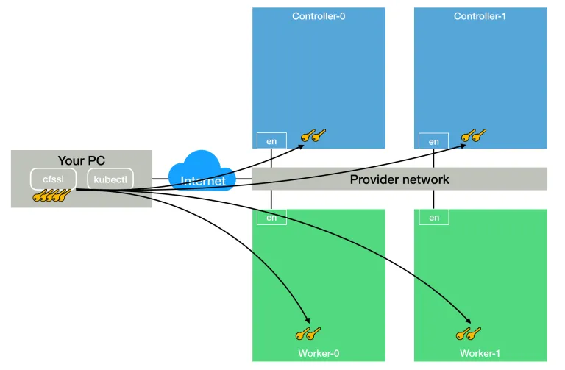
2- Provisioning a CA and Generating TLS Certificates
https://github.com/TunisJAM/kubernetes-the-hard-way-aws/blob/master/docs/04-certificate-authority.md
Notes:
choco install kubernetes-cli
PS C:\Windows\system32>Invoke-WebRequest -Uri https://pkg.cfssl.org/R1.2/cfssl_windows-amd64.exe -OutFile cfssl.exe
PS C:\Windows\system32>Invoke-WebRequest -Uri https://pkg.cfssl.org/R1.2/cfssljson_windows-amd64.exe -OutFile cfssljson.exe
cfssl version
Cfssljson -version

Slide 22
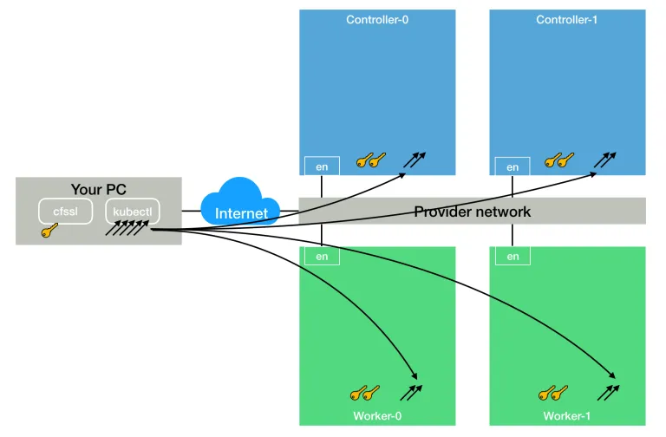
3- Generating Kubernetes Configuration Files for Authentication
https://github.com/TunisJAM/kubernetes-the-hard-way-aws/blob/master/docs/05-kubernetes-configuration-files.md

Slide 23
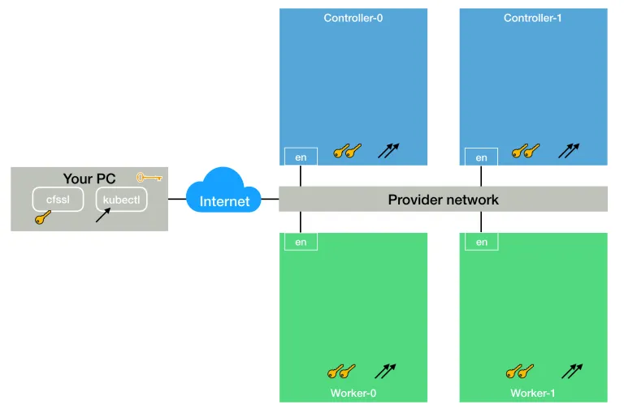
4- Generating the Data Encryption Config and Key
https://github.com/TunisJAM/kubernetes-the-hard-way-aws/blob/master/docs/06-data-encryption-keys.md

Slide 24
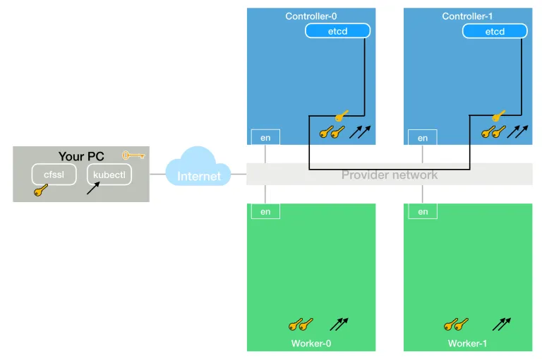
5- Bootstrapping the etcd Cluster
https://github.com/TunisJAM/kubernetes-the-hard-way-aws/blob/master/docs/07-bootstrapping-etcd.md

Slide 25
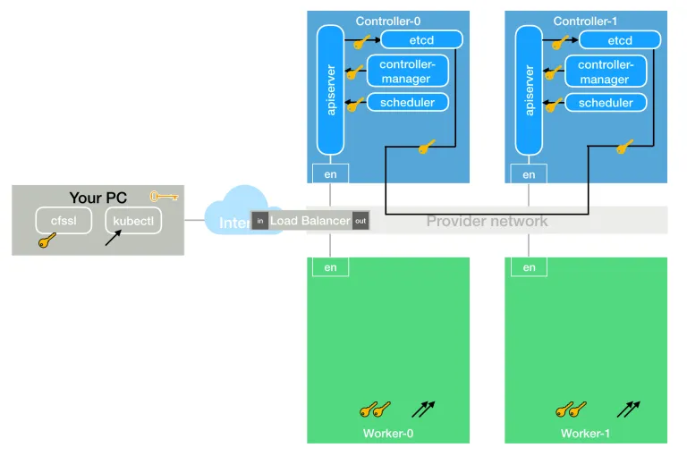
6- Bootstrapping the Kubernetes Control Plane
https://github.com/TunisJAM/kubernetes-the-hard-way-aws/blob/master/docs/08-bootstrapping-kubernetes-controllers.md

Slide 26
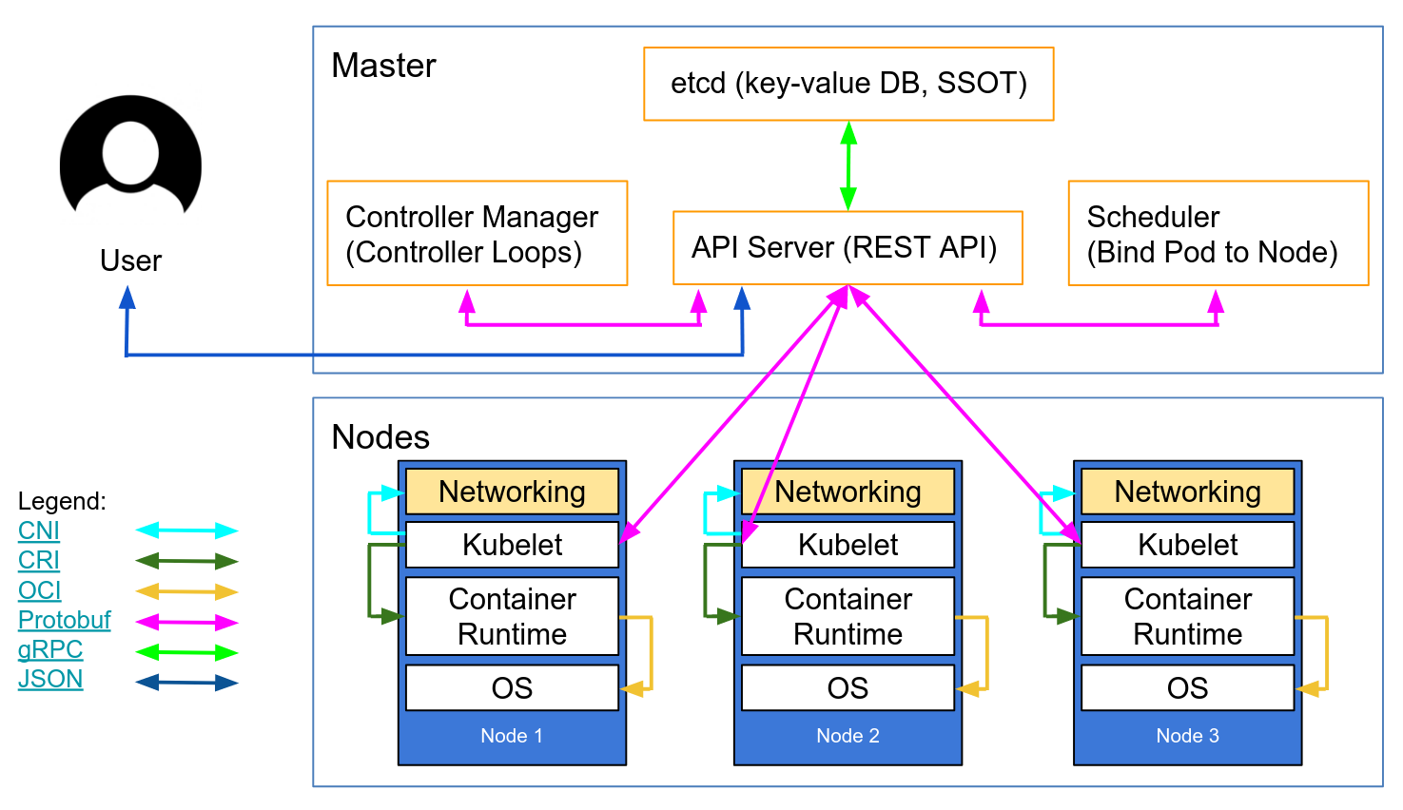
6- Bootstrapping the Kubernetes Control Plane
https://github.com/TunisJAM/kubernetes-the-hard-way-aws/blob/master/docs/08-bootstrapping-kubernetes-controllers.md

Slide 27
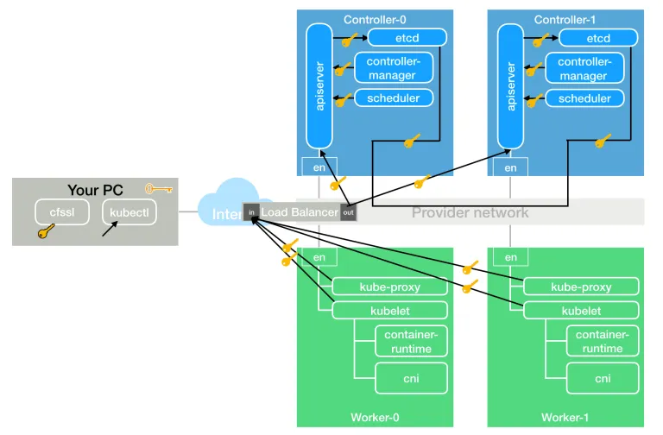
7- Bootstrapping the Kubernetes Worker Nodes
https://github.com/TunisJAM/kubernetes-the-hard-way-aws/blob/master/docs/09-bootstrapping-kubernetes-workers.md

Slide 28

8- Configuring kubectl for Remote Access
https://github.com/TunisJAM/kubernetes-the-hard-way-aws/blob/master/docs/10-configuring-kubectl.md

Slide 29
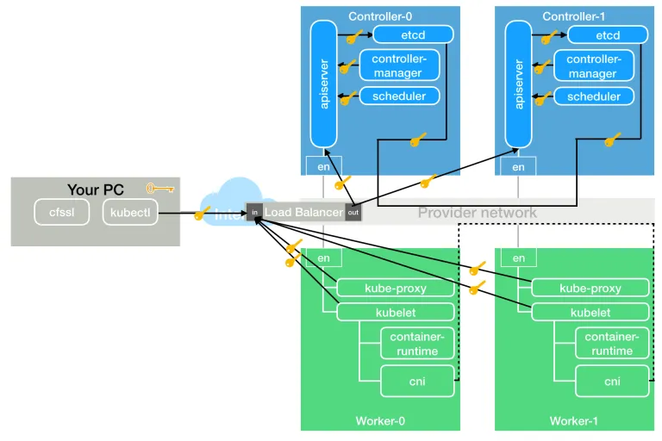
9- Provisioning Pod Network Routes
https://github.com/TunisJAM/kubernetes-the-hard-way-aws/blob/master/docs/11-pod-network-routes.md

Slide 30
10- Deploying the DNS Cluster Add-on
https://github.com/TunisJAM/kubernetes-the-hard-way-aws/blob/master/docs/12-dns-addon.md

Slide 31
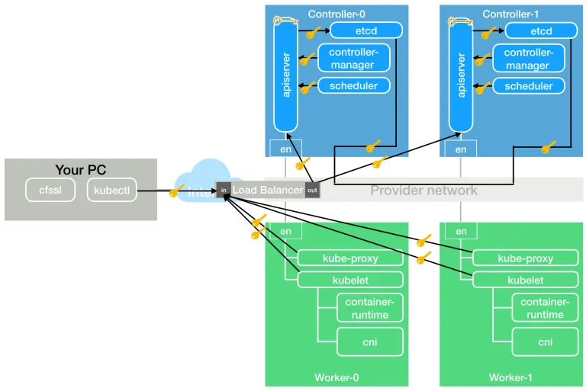
11- Smoke Test
https://github.com/TunisJAM/kubernetes-the-hard-way-aws/blob/master/docs/13-smoke-test.md
Notes:
At the end, your component would communicates!

Slide 32
12- Cleaning Up
https://github.com/TunisJAM/kubernetes-the-hard-way-aws/blob/master/docs/14-cleanup.md

Slide 33
Part 4:
Istio, a modern service mesh

Slide 34
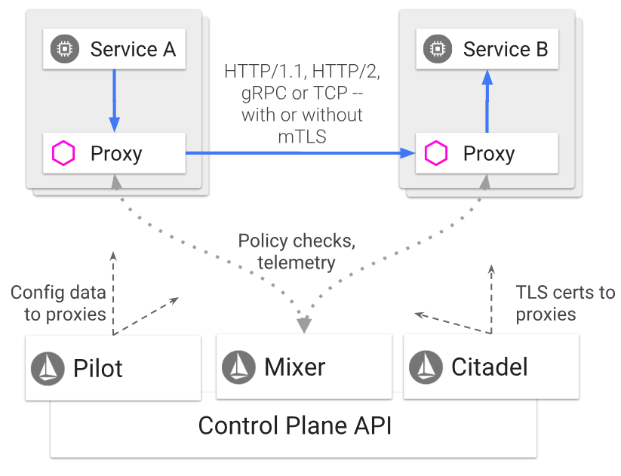
ISTIO architecture

